Slide 1
MAPpoly training section
Marcelo Mollinari
mmollin@ncsu.edu
SCRI Workshop – January 13, 2021

Slide 2
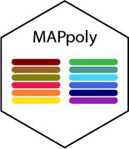
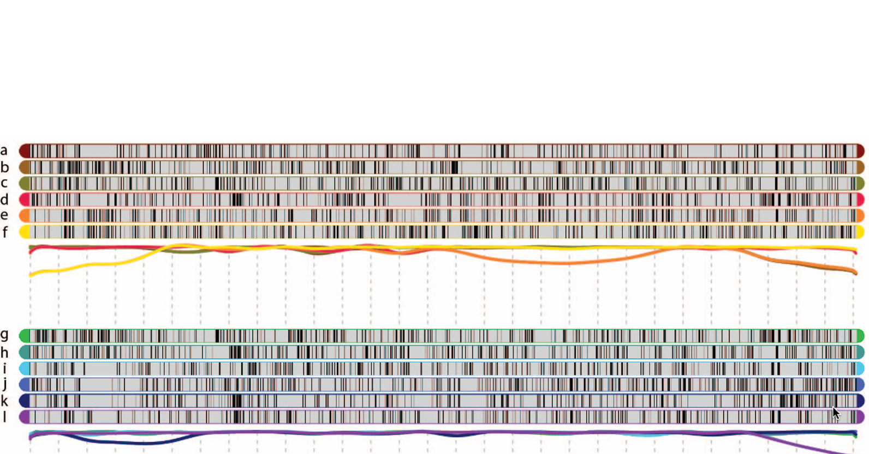
Outline
Installation
Reading/import datasets
Filtering
Two-point analysis
Grouping
Ordering
Phasing
Modeling errors/genotype probabilities
Final checking
Map summary/results
Genotype probabilities
Preferential pairing/haplotype probabilities
Appendix: meiotic analysis

Slide 3
On-line resources
MAPpoly web page
GitHub page for this presentation
Tetraploid tutorial:
Script for this presentation
B2721 potato biparental population (Atlantic x B1829-5)
Hexaploid tutorial: TBA
BT sweetpotato population (Beauregard x Tanzania)
Detailed analytic procedures for Pereira et al. (2020)

Slide 4
Initial notes about MAPpoly
Primary intention when developing MAPpoly was construct genetic maps in hexaploids
Obtain conditional probabilities for QTL analysis
It does not model double reduction: double reduced markers/individuals are treated as missing data

Slide 5

Installation
From CRAN (stable version)
install.packages("mappoly")
From GitHub (development version)
install.packages("devtools")
devtools::install_github("mmollina/mappoly", dependencies=TRUE)

Slide 6


Reading/importing data sets
Supported datasets
MAPpoly files
Discrete dosage
Dosage probability
CSV files
fitPoly files
Dosage Probability
VCF files
Discrete dosage
Dosage probability
Supported R objects
updog objects
polyRAD objects
polymapR
datasets
maps
data set
mappoly.data

Slide 7
Reading/importing datasets
MAPpoly data reading functions
1. MAPpoly
dat.mappoly <- read_geno(file.in = 'path_to_input_file')
2. MAPpoly with genotype probabilities
dat.mappoly.prob <- read_geno_prob(file.in = 'path_to_input_file)
3. CSV
dat.csv <- read_geno_csv(file.in = 'path_to_input_file', ploidy = 6)
4. fitPoly, supports genotype probabilities
dat.fitpoly <- read_fitpoly(file.in = 'path_to_input_file', ploidy = 6,
parent1 = 'P1', parent1 = 'P2')
5. VCF files, supports genotype probabilities (PL field)
dat.vcf <- read_vcf(file.in = 'path_to_input_file', ploidy = 6,
parent1 = 'P1', parent1 = 'P2',
min.gt.depth = 0, min.av.depth = 0)

Slide 8
Reading/importing datasets
MAPpoly data importing functions
1. updog
dat.updog <- import_from_updog(object = input_multidog_object)
2. polyRAD
dat.polyRAD <- polyRAD::Export_MAPpoly(object = 'polyrad_object')
3. polymapR
Importing data
dat.polymapr <- import_data_from_polymapR(input.data = polymapR_screened_data,
ploidy = 6, parent1 = 'P1',
parent1 = 'P2')
Importing maps
map.polymapr <- import_phased_maplist_from_polymapR(maplist = phased_maplist,
mappoly.data = mappoly.data)

Slide 9

Reading/importing datasets
Example: reading fitPoly files
## Downloading data from GitHub
library("mappoly")
setwd("SCRI/MAPpoly/tetra")
address <- "https://github.com/mmollina/SCRI/raw/main/data/fitpoly_tetra_call/B2721_scores.zip"
download.file(url = address, destfile = "B2721_scores.zip")
unzip(tempfl, files = "B2721_scores.dat")
## Reading fitPoly data
dat <- read_fitpoly(file.in = "B2721_scores.dat",
ploidy = 4,
parent1 = "Atlantic",
parent2 = "B1829",
verbose = TRUE)
source("get_solcap_snp_pos.R")
plot(dat)
print(dat, detailed = TRUE)
Genotype calling using fitPoly:
https://github.com/mmollina/SCRI/blob/main/data/fitpoly_tetra_call/B2721_fitpoly_call.R
Adding Solanum tuberosum genome v4.03 information:
https://github.com/mmollina/SCRI/blob/main/MAPpoly/get_solcap_snp_pos.R

Slide 10
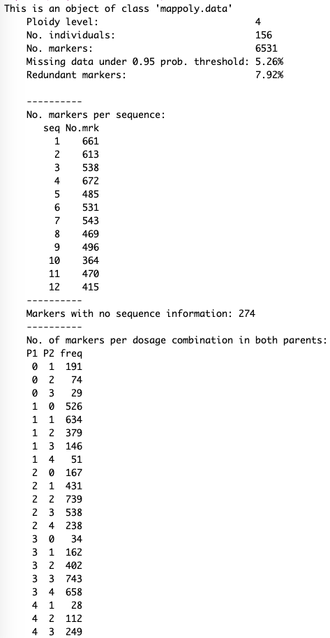
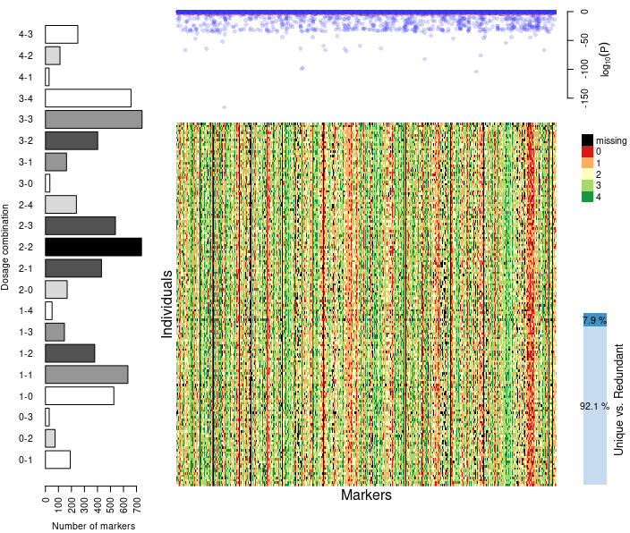
Inspecting data loaded from fitPoly files

Slide 11
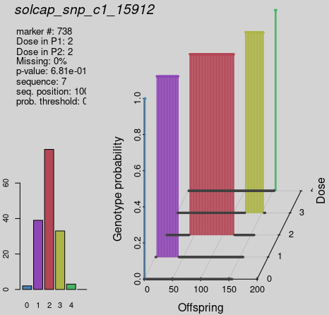
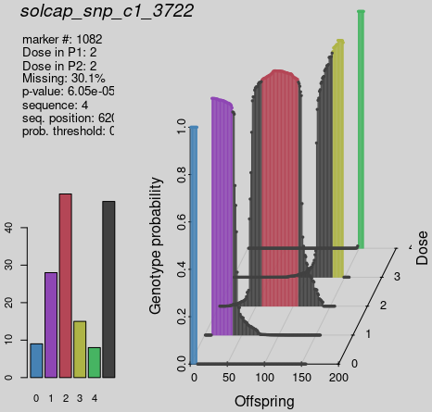
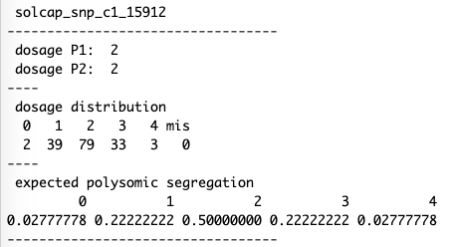
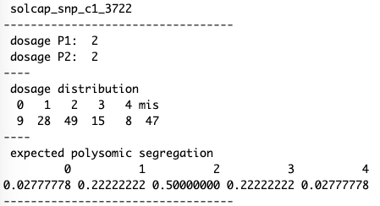
Inspecting specific marker
plot_mrk_info(dat, 738)
print_mrk(dat, 738)
plot_mrk_info(dat, "solcap_snp_c1_3722")
print_mrk(dat, "solcap_snp_c1_3722")
4

Slide 12
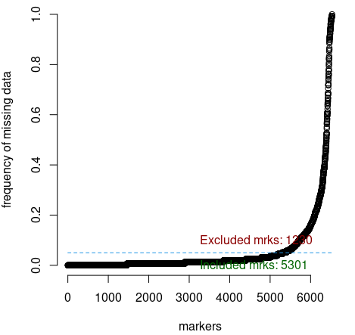
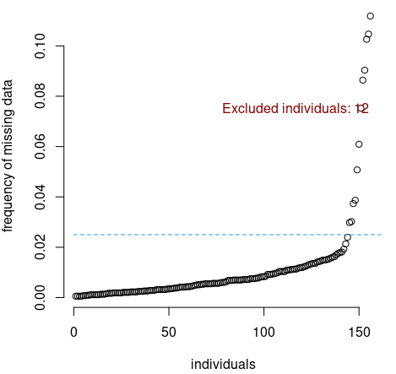
Filtering by missing data
dat <- filter_missing(input.data = dat,
type = "marker",
filter.thres = 0.05)
dat <- filter_missing(input.data = dat,
type = "individual",
filter.thres = 0.025)
4

Slide 13
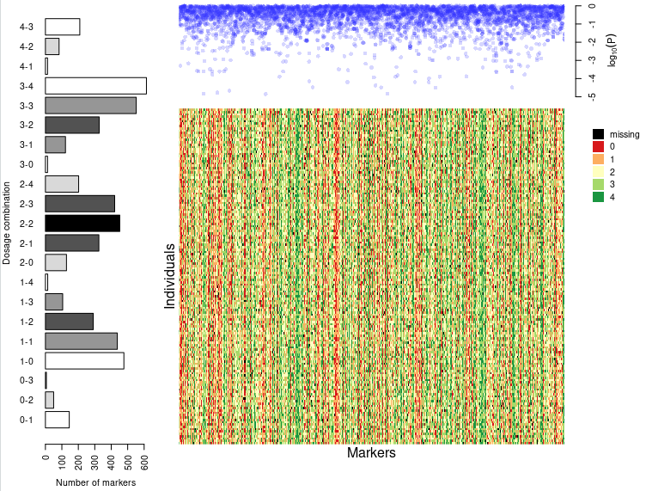
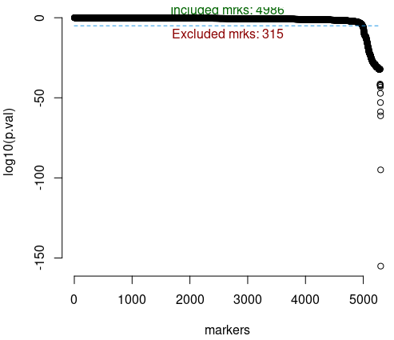
Filtering by segregation distortion
s <- filter_segregation(input.data = dat, chisq.pval.thres = 0.05/dat$n.mrk)
s <- make_seq_mappoly(s)
plot(s)
4

Slide 14
Making a sequence of markers
mappoly.data
mappoly.group
mappoly.map
mappoly.chitest.seq
mappoly.sequence
mappoly.pcmap
mappoly.geno.ord

Slide 15

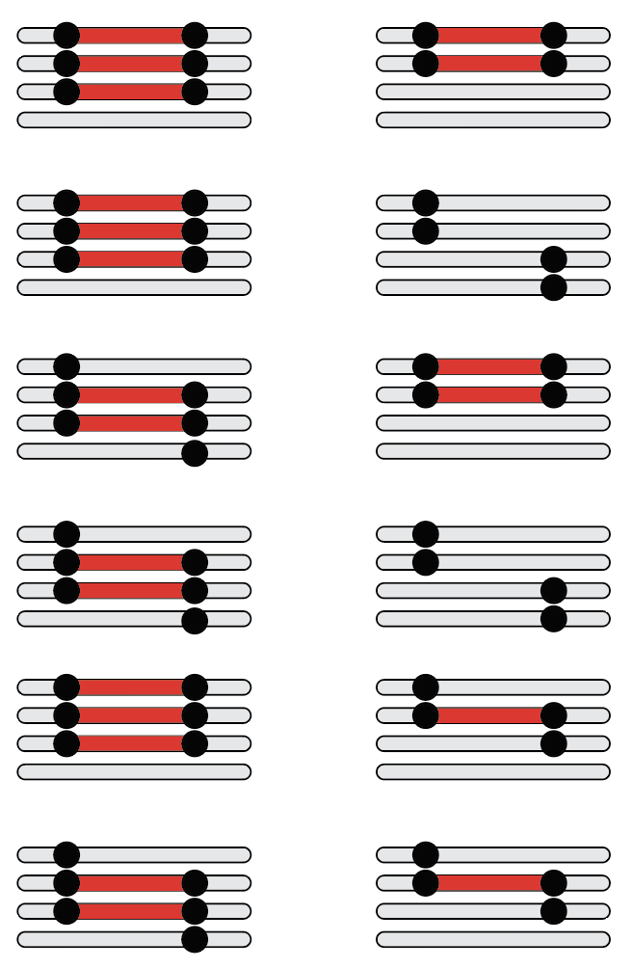
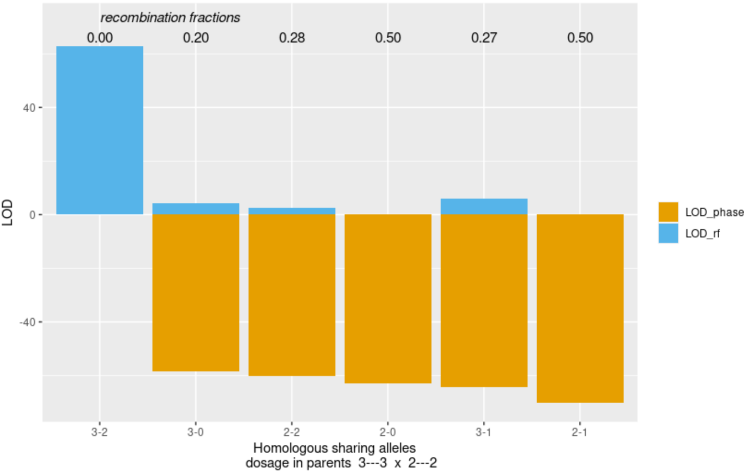
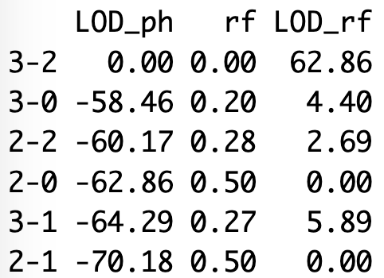
Two-point analysis
## Two-point analysis
nc <- parallel::detectCores() - 1
tpt10 <- est_pairwise_rf(s10, ncpus = nc, est.type = "disc")
tpt10$pairwise[90:92]
round(tpt10$pairwise[[91]], 2)
plot(tpt10, first.mrk = 1, second.mrk = 2074)
Atlantic
B1829-5
1
2074
1
2074

Slide 16
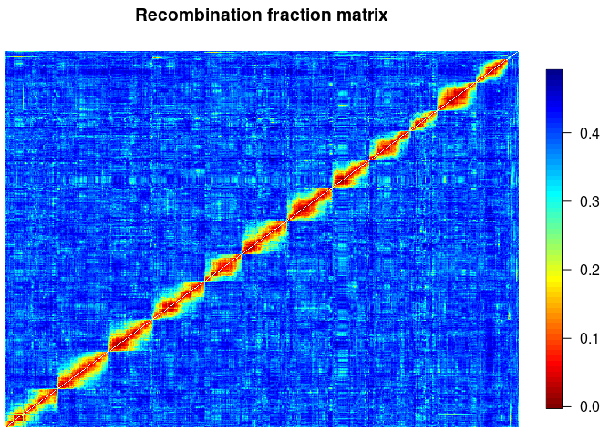
Recombination fraction matrix
m <- rf_list_to_matrix(tpt, ncpus = nc)
gen.ord <- get_genomic_order(s)
s.gen.ord <- make_seq_mappoly(gen.ord)
plot(m, ord = s.gen.ord$seq.mrk.names, fact = 10)

Slide 17
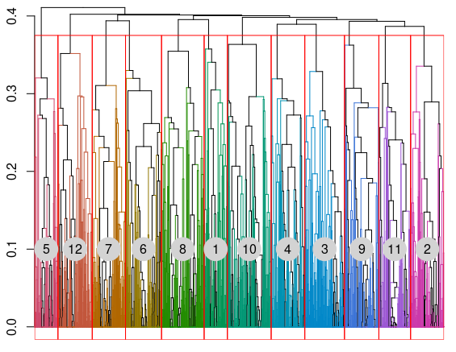
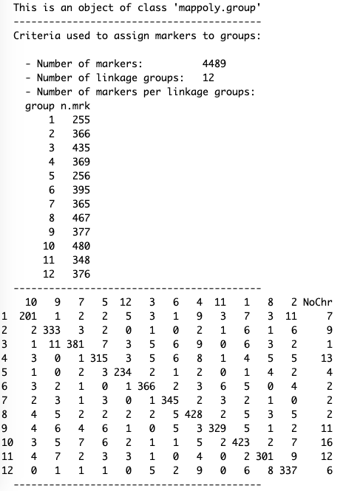
Filtering by pairwise recombination fraction
gr <- group_mappoly(m, expected.groups = 12,
comp.mat = TRUE)
gr

Slide 18
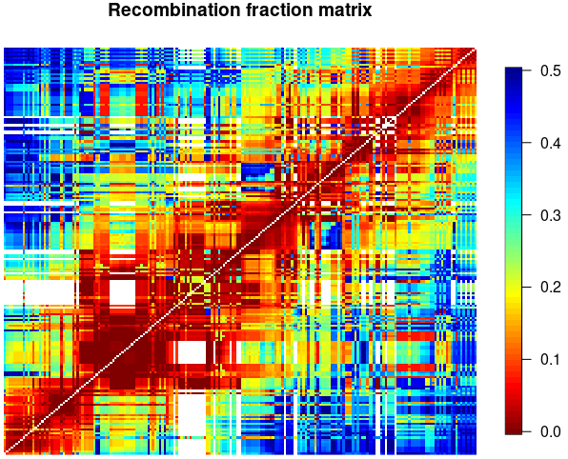
Ordering within a specific linkage group
Genome order
s1 <- make_seq_mappoly(gr, arg = 1,
genomic.info = 1)
tpt1 <- make_pairs_mappoly(tpt, s1)
m1 <- make_mat_mappoly(m, s1)
##Genomic order
g.o1 <- get_genomic_order(s1)
s1.g <- make_seq_mappoly(g.o1)
plot(g.o1)
plot(m1, ord = s1.g$seq.mrk.names,
fact = 3)

Slide 19
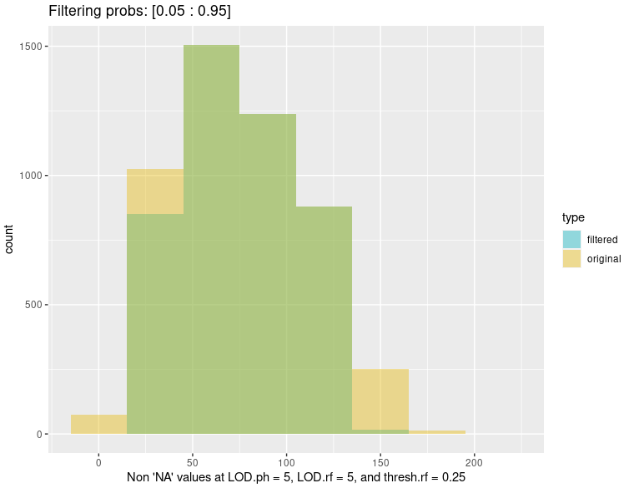
Filtering by pairwise recombination fraction
sf <- rf_snp_filter(input.twopt = tpt,
thresh.LOD.ph = 5,
thresh.LOD.rf = 5,
thresh.rf = 0.25,
probs = c(0.05, 0.95))
mf <- make_mat_mappoly(m, sf)

Slide 20
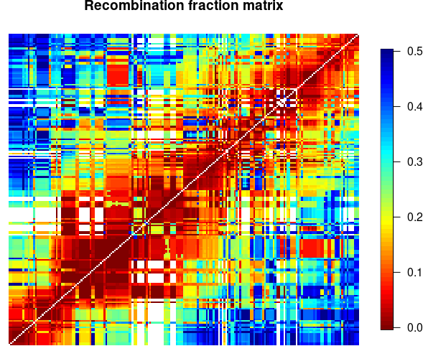
Ordering within a specific linkage group
MDS order
mds.o1 <- mds_mappoly(m1, n = c(201,47))
plot(mds.o1)
s1.mds <- make_seq_mappoly(mds.o1)
plot(m1, ord = s1.mds$seq.mrk.names)

Slide 21
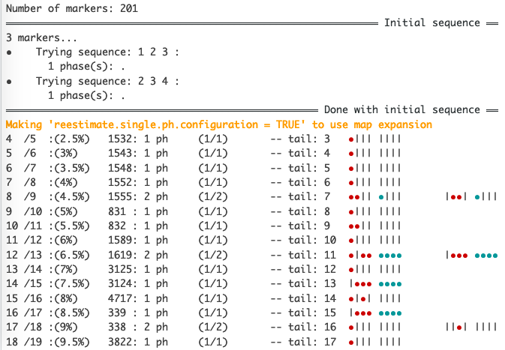
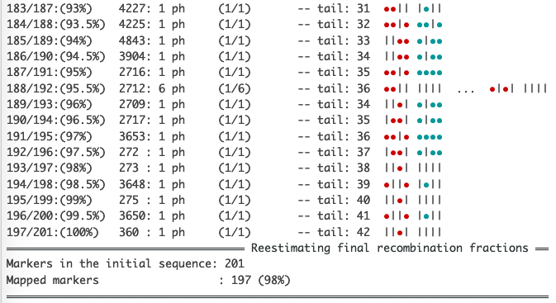
Phasing and HMM estimation of distance
lg1.geno.map<-est_rf_hmm_sequential(input.seq = s1.g,
start.set = 3,
thres.twopt = 10,
thres.hmm = 50,
extend.tail = 30,
twopt = tpt1,
verbose = TRUE,
tol = 10e-2,
tol.final = 10e-4,
phase.number.limit = 20,
sub.map.size.diff.limit = 5,
info.tail = TRUE)

Slide 22
Phasing and HMM estimation of distance
Tetraploid
Hexaploid
Argument | Value
start.set | 3 – 10
thres.twopt | 10
thres.hmm | 10 – 50
extend.tail | 30 – 100
phase.number.limit | 20
sub.map.size.diff.limit | 2 (thousands per LG) … 10 (hundred(s) per LG)
Argument | Value
start.set | 3 – 5
thres.twopt | 10
thres.hmm | 10 – 50
extend.tail | 50 – 200
phase.number.limit | 20
sub.map.size.diff.limit | 2 (thousands per LG) … 10 (hundred(s) per LG)

Slide 23
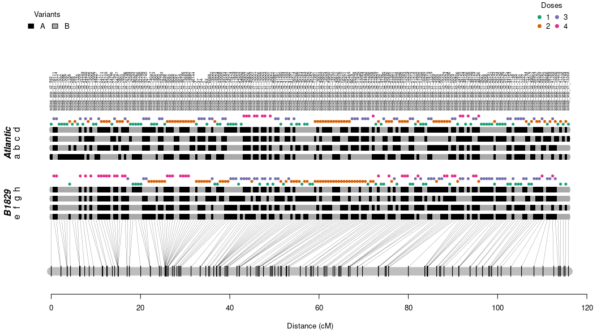
Resulting map
plot(lg1.geno.map, mrk.names = TRUE, cex = 0.5, P = "Atlantic", Q = "B1829")

Slide 24
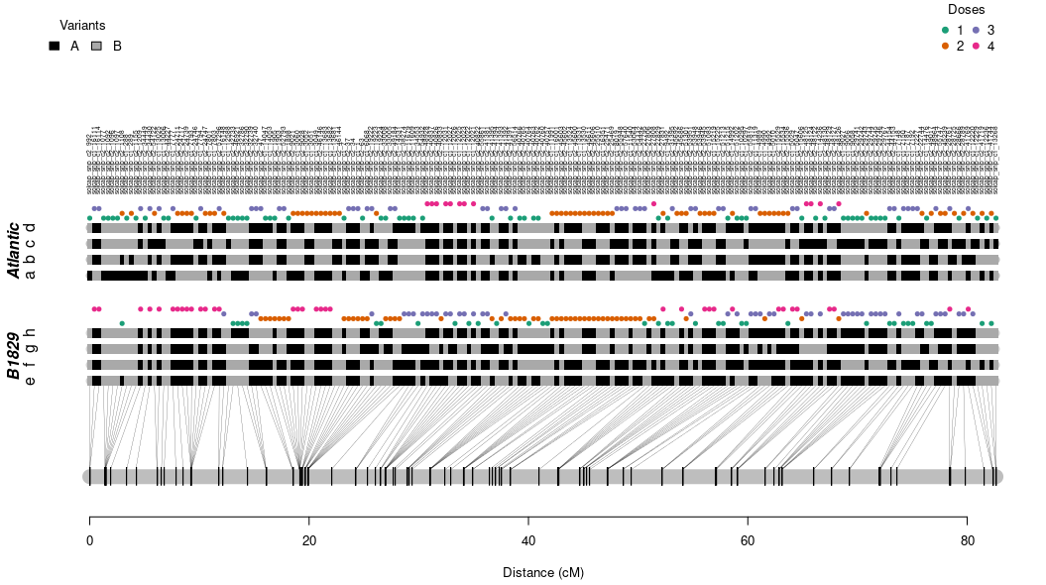
Resulting map – error modeling
lg1.geno.map.err <- est_full_hmm_with_global_error(lg1.geno.map, error = 0.05, tol = 10e-4)
plot(lg1.geno.map.err, mrk.names = TRUE, cex = 0.5, P = "Atlantic", Q = "B1829")

Slide 25
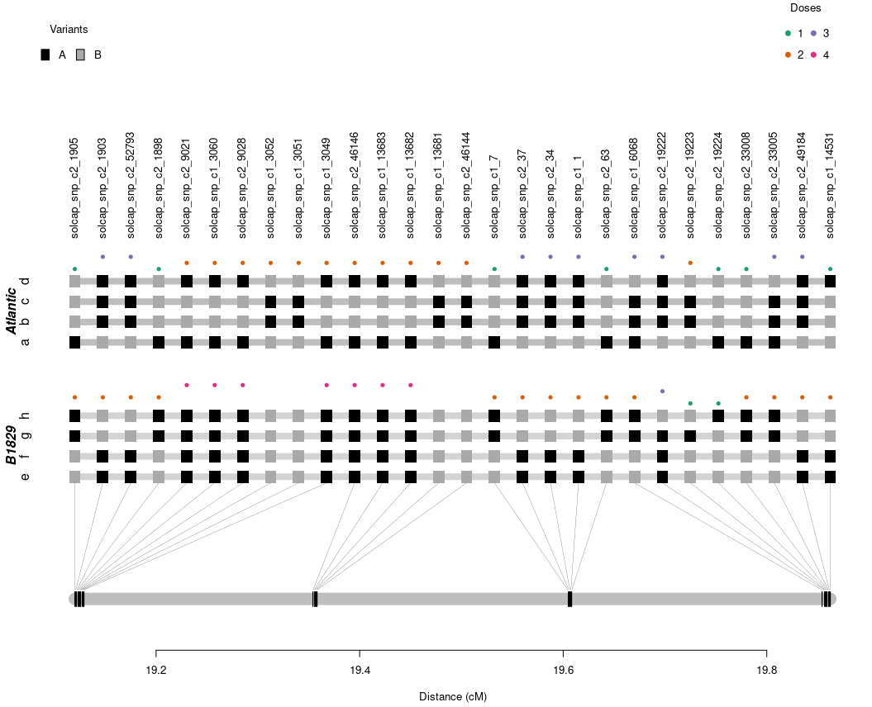
Resulting map: 20-30 cM segment
plot(lg1.geno.map.err,
mrk.names = TRUE,
left.lim = 19,
right.lim = 20,
P = "Atlantic",
Q = "B1829")

Slide 26
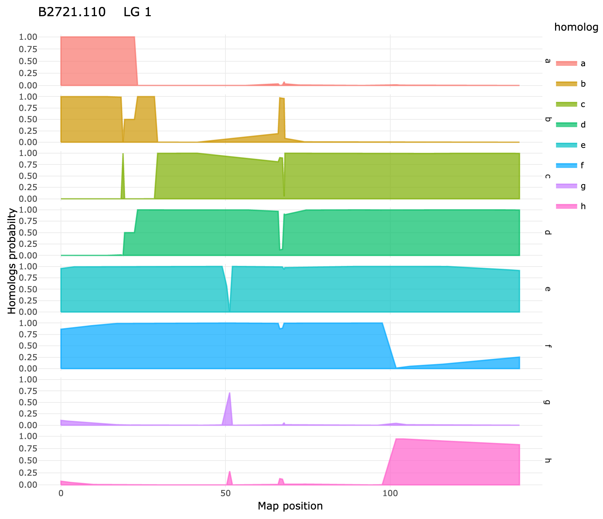
Probabilistic haplotype reconstruction
g.lg10 <- calc_genoprob(lg10.geno.map, step = 1)
h.lg10 <- calc_homoprob(g.lg10)
plot(h.lg10, ind = "B2721.110")

Slide 27
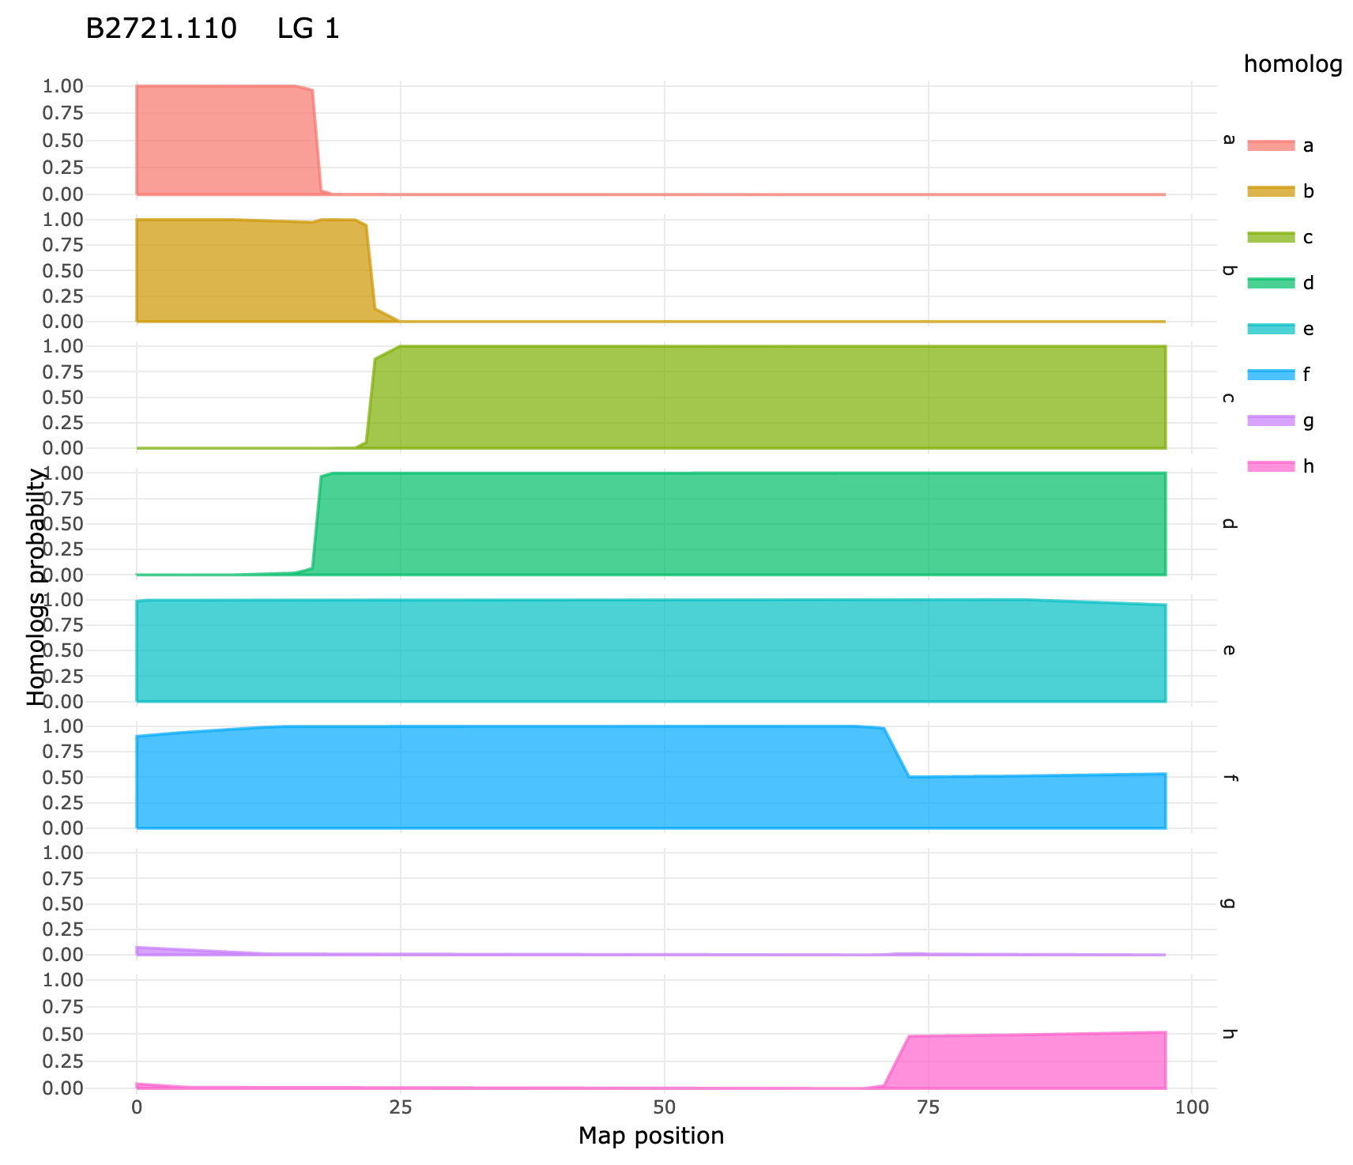
Probabilistic haplotype reconstruction
g.lg10.err <- calc_genoprob_error(lg10.geno.map.err, step = 1, error = 0.05)
h.lg10.err <- calc_homoprob(g.lg10.err)
plot(h.lg10.err, ind = "B2721.110")

Slide 28
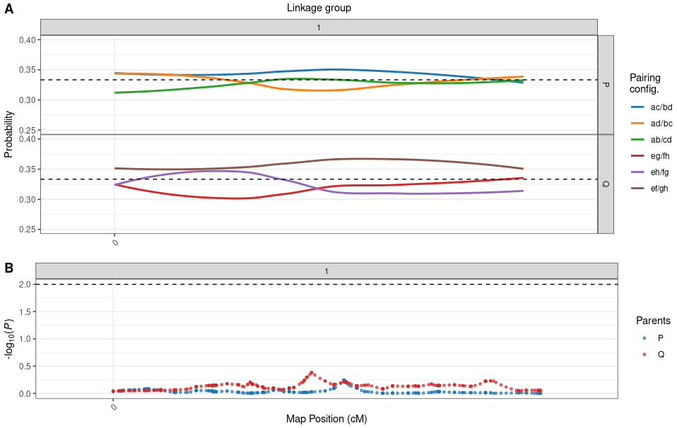
Preferential pairing profiles
p1 <- calc_prefpair_profiles(g1)
plot(p1, min.y.prof = 0.25, max.y.prof = 0.40)

Slide 29
Parallel map construction – genomic order
#### Functions ####
phasing_and_hmm_rf <- function(X){
dir.create("map_output", showWarnings = FALSE)
fl <- paste0("output_map_ch_", X$seq$sequence[1], ".txt")
fl <- file.path("map_output", fl)
sink(fl)
map <- est_rf_hmm_sequential(input.seq = X$seq,
start.set = 3,
thres.twopt = 10,
thres.hmm = 50,
extend.tail = 30,
twopt = X$tpt,
verbose = TRUE,
phase.number.limit = 20,
sub.map.size.diff.limit = 5)
sink()
return(map)
}
error_model <- function(X, error = 0.05, tol = 10e-4){
x <- est_full_hmm_with_global_error(input.map = X,
error = error,
tol = tol,
verbose = FALSE)
return(x)
}
#### Parallel map construction
cl <- parallel::makeCluster(12)
parallel::clusterEvalQ(cl, require(mappoly))
parallel::clusterExport(cl, "dat")
# ~12.5 minutes
MAPs.geno <- parallel::parLapply(cl, LGS, phasing_and_hmm_rf)
# ~2.5 minutes
MAPs.geno.err <- parallel::parLapply(cl, MAPs.geno,
error_model)
# ~22 seconds
genoprob <- parallel::parLapply(cl,
MAPs.geno.err,
calc_genoprob_error,
step = 1,
error = 0.05)
parallel::stopCluster(cl)
#### Map results
map.out <- plot_map_list(MAPs.geno.err, col = "ggstyle")
map.out
plot_genome_vs_map(MAPs.geno.err, same.ch.lg = TRUE)
summary_maps(MAPs.geno.err)
export_map_list(MAPs.geno.err, file = "output_map.csv")
#### Correspondence with genome
z<-as.numeric(colnames(gr$seq.vs.grouped.snp)[1:12])
#### Assembling linkage groups (order based on genome)
LGS<-vector("list", 12)
for(ch in 1:12){
cat("\n ~~~~~~ ch:", ch, "...\n")
lg <- which(z==ch)
s.temp<-make_seq_mappoly(gr, lg, genomic.info = 1)
tpt.temp <- make_pairs_mappoly(tpt, s.temp)
s.temp.filt <- rf_snp_filter(tpt.temp, 5, 5, 0.15, c(0.05, 1))
m.temp <- make_mat_mappoly(m, s.temp.filt)
g.o <- get_genomic_order(s.temp)
s.g <- make_seq_mappoly(g.o)
tpt.temp <- make_pairs_mappoly(tpt, input.seq = s.g)
LGS[[ch]] <- list(seq = s.g, tpt = tpt.temp)
}
#### Preferential pairing
pp <- calc_prefpair_profiles(genoprob)
print(pp)
head(pp$prefpair.psi)
plot(pp, P = "Atlantic", Q = "B1829")
#### Haplotype probabilities
hp <- calc_homoprob(genoprob)
print(hp)
plot(hp, ind = 2, lg = 1)
plot(hp, ind = 2, lg = 1:12, use.plotly = FALSE)

Slide 30
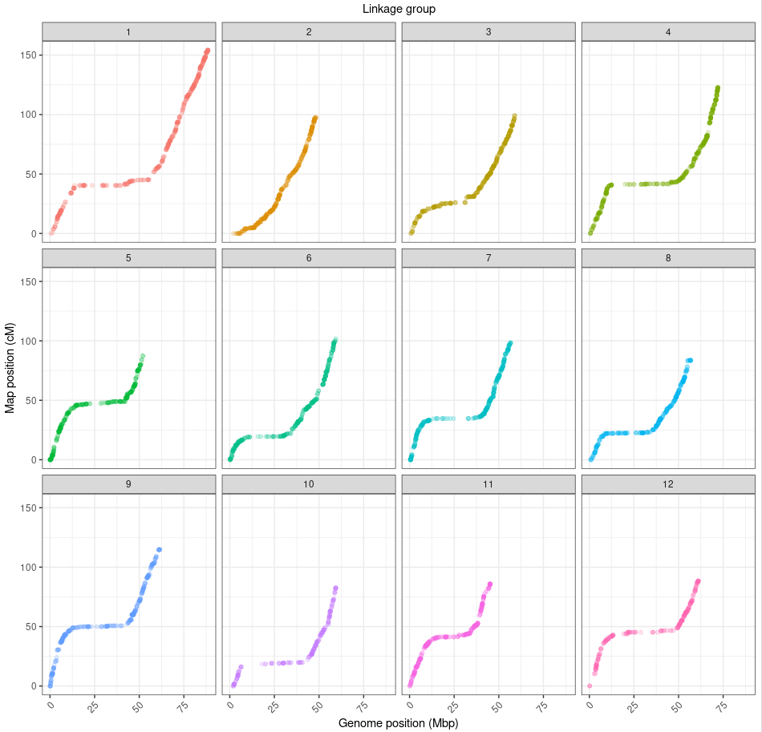
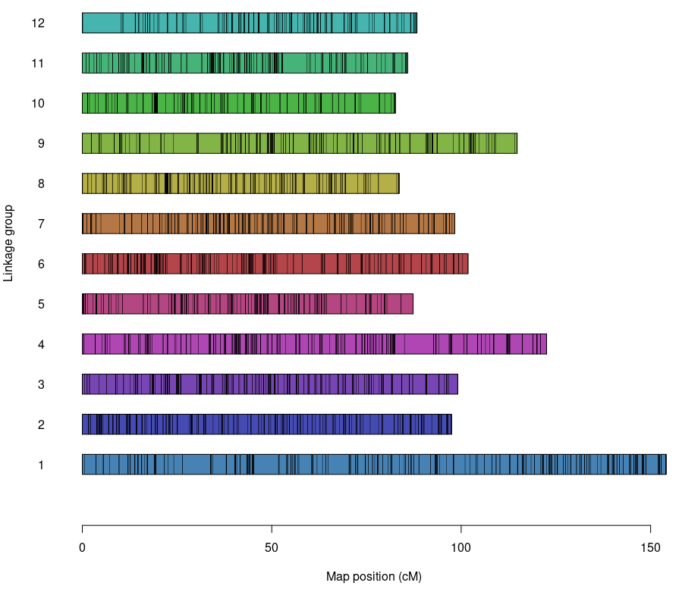
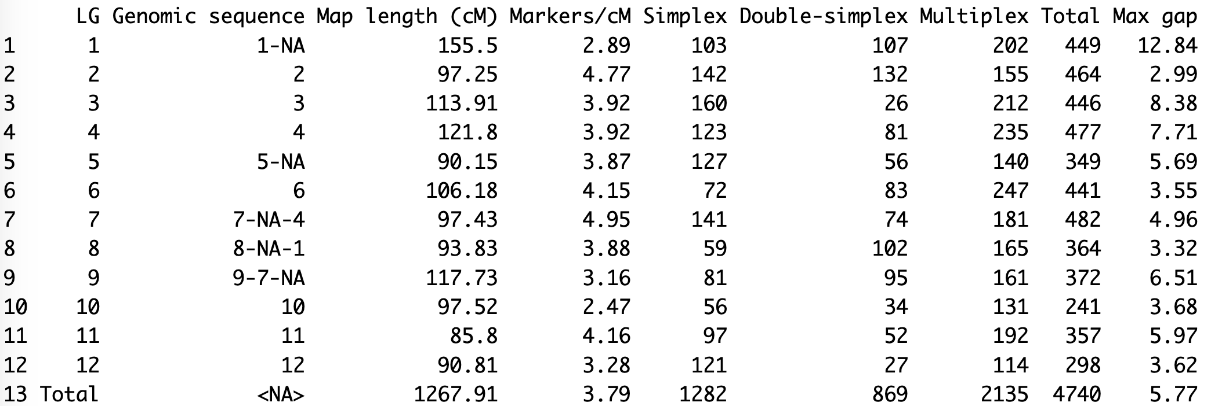
Results

Slide 31
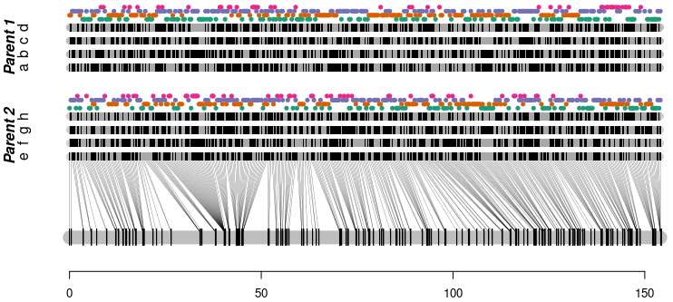
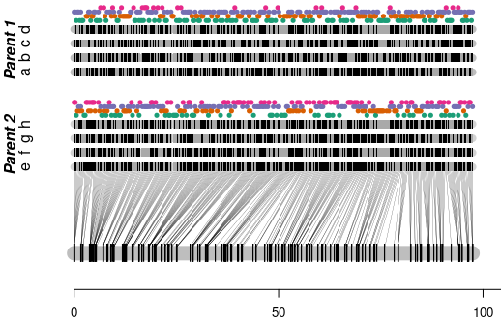
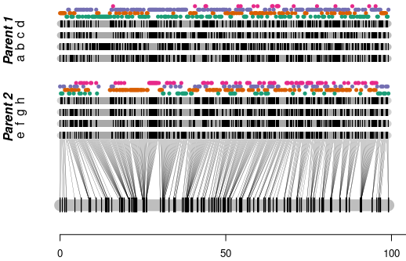
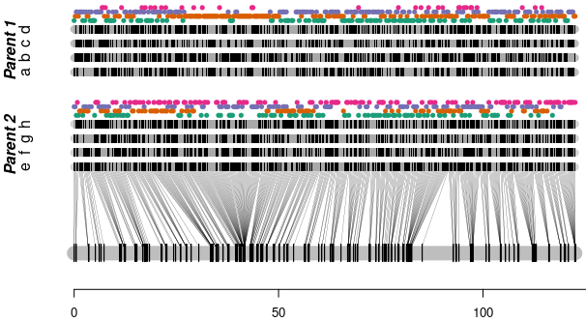
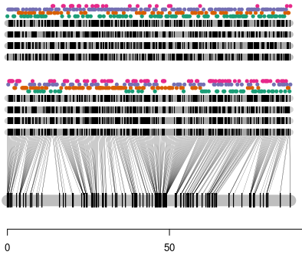
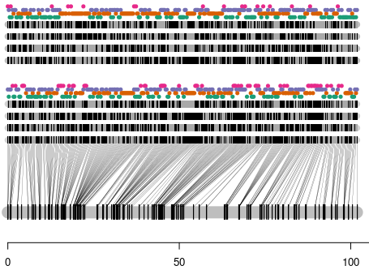
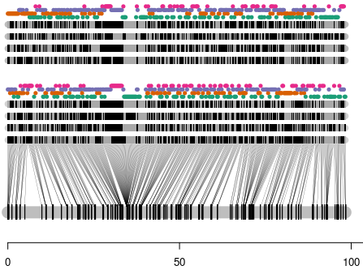
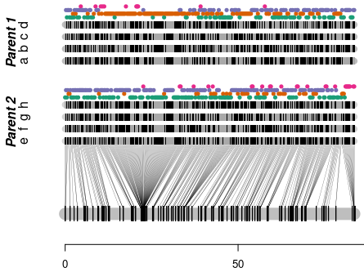
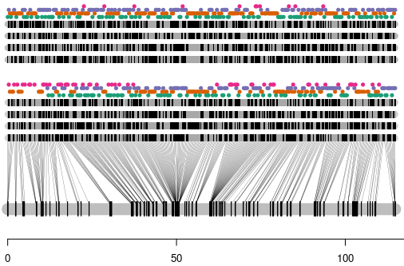
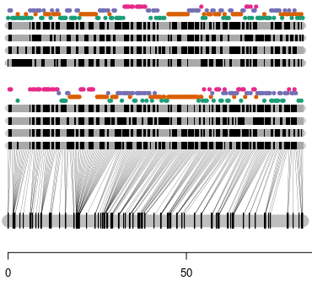
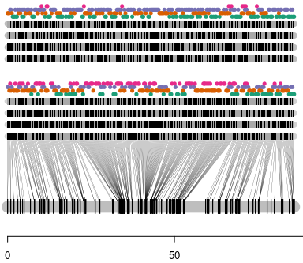
Results

Slide 32
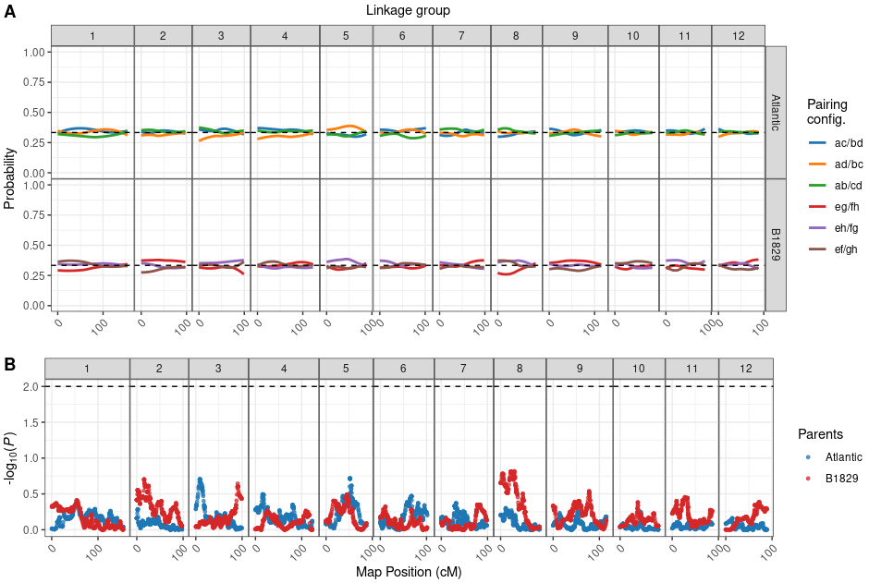
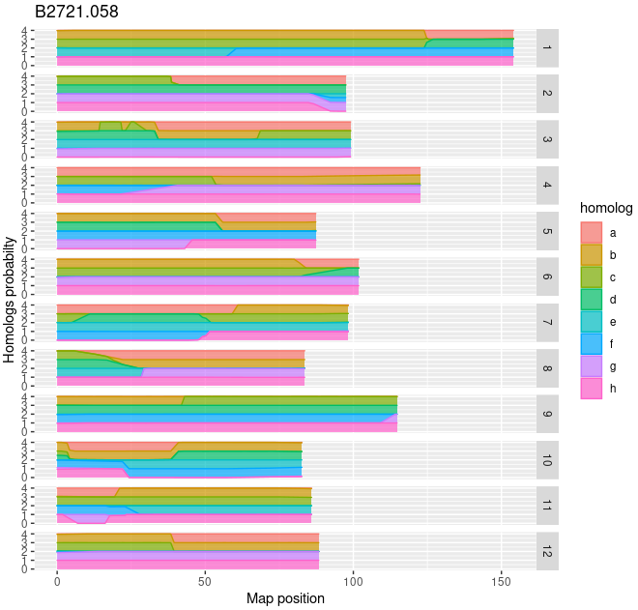
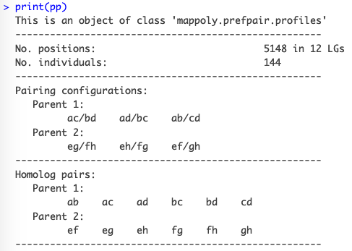
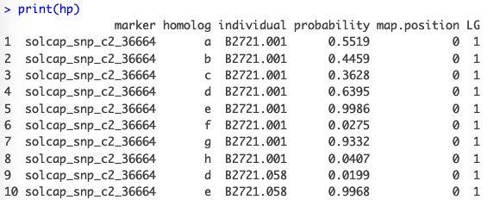
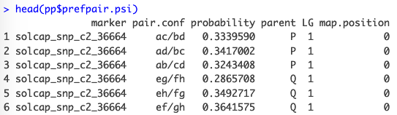
Results

Slide 33
Reading/importing datasets
Example: reading VCF files
6
dat <- NULL
for(i in c(3,9,12)){ #for the complete dataset use 1:12 instead
cat("Loading chromosome", i, "...")
tempfl <- tempfile(pattern = paste0("ch", i), fileext = ".vcf.gz")
x <- "https://github.com/mmollina/MAPpoly_vignettes/raw/master/data/BT/sweetpotato_chr"
address <- paste0(x, i, ".vcf.gz")
download.file(url = address, destfile = tempfl, quiet = TRUE)
dattemp <- read_vcf(file = tempfl, parent.1 = "PARENT1", parent.2 = "PARENT2",
ploidy = 6, verbose = FALSE)
dat <- merge_datasets(dat, dattemp)
cat("\n")
}
unlink(tempfl)
plot(dat)
print(dat, detailed = TRUE)

